Slide 1
Economic Porosity and Primitive Capital Accumulation in Mozambique
Carlos Nuno Castel-Branco
Research Director at IESE, Maputo (www.iese.ac.mz)
Associate Professor, Eduardo Mondlane University, Maputo
Associate Senior Researcher at SOAS (University of London) & IDPM (University of Manchester) carlos.castelbranco@gmail.com
International Workshop on “Taxation and State Formation in Sub Saharan Africa”, organized by the Public Affairs Research Institute (PARI) & the Friedrich Ebert Stiftung (FES), at the University of Witwatersrand, Johannesburg, South Africa, 20-22 June 2016

Slide 2
Struture of the presentation
“Taxation and State formation” within a broader, political economy perspective – to understand problems and challenges, to understand and define direction of change
Economic porosity: definitions and consequences
The argument: historical rationale for economic porosity
Magnitude of economic porosity: Structure of economic dynamics, Taxes on mega projects, Investment and reinvestment, Capital flight, Public debt
Questions/challenges for “taxation and State building”

Slide 3
Taxation and State Formation within a broader, political economy perspective

Slide 4
Taxation and State formation within a broader, political economy perspective
What do we want to do/achieve?
Tax Whom or What?
How Much?
Can the State Tax?
Are there Alternatives to Taxation?
Answers to those questions depend on
Social priorities
Economic structures, history and dynamics
Relationship between the State, Capital and Labour
System of accumulation of private capital

Slide 5
Economic Porosity – definition and consequences

Slide 6
Defining Economic Porosity
Inability, deliberate or nor, to retain, socially, uncommitted surplus that could be utilised for the reproduction of the economy as a whole
Three types of economic porosity
  Type I: outflows of surplus from the domestic to the world economy, that would favour foreign capital. Most of type I porosity may be captured, ceteris paribus, by the difference between GDP and GNP (if GDP > GNP, economic porosity > 0)
  Type II: transfers of surplus and income from public to private (domestic and foreign) capital, particularly frequent and intense in times of crisis and initial (primitive) stages of capital accumulation (reigniting or igniting processes of private capital accumulation). We can, also, describe this process as one of expropriation of the state for private gain. Type II porosity may not be fully captured by GDP > GNP, as part of the social loss through porosity becomes a private gain in profits, interest and rents accruing to domestic capitalists, and so more information is required about structural conditions (fiscal and monetary, patterns of investment and resource allocation, ability or inability of the state to pursue broader social and economic policies as economic surplus expands, etc.)
  Type III: social austerity to compensate for Types I and II, which means generalized social expropriation of surplus for igniting or reigniting capitalist accumulation.

Slide 7
Consequences of Economic Porosity
Four major impacts of economic porosity
  Difficulty in mobilizing resources for broad-based social and economic development, even when surplus is expanding, leading to dynamics of uneven capitalist development (in and between firms, regions and countries)
  Subordination of public policy and economic and social opportunities and options to dominant market interests (those that are being favoured or financed by economic porosity), leading to narrow based development, growth and economic transformation (depending on the specific historical characteristics and contexts of the processes of porosity, adjustment and accumulation, this may lead to economic bubbles and/or recession of some sort, and/or social unrest)
  Further concentration (larger economic units) and centralisation (fewer economic units) of capital, which restructure capital around dominant market interests and consolidate their dominance over markets and public policy – depending on specific historical conditions, these may result in expansion or contraction or other significant structural changes in industrial capacities, or, simply, in a more speculative economy in which interest bearing (or fictitious) capital dominates over real capital (in which case, economic expansion goes hand in hand with the inability to generate jobs and provide generalised improvements in productivity and in living conditions for the society as a whole).
  Emergence or restructuring of capitalist groups, depending on specific historical conditions and stages of capitalist accumulation – for example, emergence and/or consolidation of financial oligarchies – which, naturally, have an impact on restructuring of labour relations and distribution of income through the economy, and expansion of commoditization into new areas.

Slide 8
Consequences of Economic Porosity
Hence, it is fundamental to understand the social and economic dynamics of porosity as these may not be simple technical flaws in the system of accounts or some known form of multinational extraction of wealth at a cost for the domestic economy that results from tax incentives, illicit capital flight, low rates of reinvestment of private capital and so on, as implications of and policy responses to economic porosity depend on such dynamics.

Slide 9
The argument – historical rationale for economic porosity

Slide 10
The argument – historical rationale of economic porosity
Long standing debate on economic porosity in Mozambique: initially focused on taxation of mega projects of the minerals-energy complex, evolving, in recent years, to incorporate other forms of porosity such as public private partnerships, financing of large private interests through public debt, and so on.
Question: why does this persist despite increasing public outcry and systematic demonstration of negative effects to the economy as a whole? Porosity may be partially created and maintained by weak institutions and capabilities, but it may also be a central component in the tripartite relationship between the state and multinational and domestic financial oligarchies. Porosity is not only an absolute loss of income to economies abroad, but it may also be part of the process of social expropriation (including the expropriation of the state) for the benefit of developing a national capitalist class – hence, a social loss for private gain.
We are not concerned with value judgements per se, but with understanding the dynamics of accumulation that emerge and the challenges they pose for broad based development, structural change and poverty reduction. Hence, we are going to explore how things can make sense together, within the circuit and accumulation of capital.

Slide 11
The argument – historical rationale of economic porosity
President Guebuza’s speech of 1986 – the capitalist manifesto in Mozambique
  Revisiting the debate on “dependent capitalism”: The danger of imperialism and the need for a class of guarantors of sovereignty – patriotic capitalists created at full speed
  Where would they come from? Political elites, aparatchiks and top administrators
  Where would capital come from? Foreign capital: initially, aid and accumulation through direct access to the state budget; later FDI and commercial loans
  Where would the physical assets come from? State assets are “our”assets
  Where would skills come from? Foreign capitalists and their executives and engineers, experienced administrators re-trained abroad, new generation trained abroad

Slide 12
The argument – historical rationale of economic porosity
Creation of national capitalist classes through the expropriation of the State
Three waves of State expropriation:
  Massive privatization of State owned companies of State owned assets in private companies – 80% to emergent political and economic, domestic elites; at low cost to them (implicit subsidies) and at a significant revenue loss for the State
  Attraction of foreign private capital and leakages to domestic, private capital accumulation: natural resources, tax incentives, public infrastructures, PPP
  Utilization of the debt space beyond its reasonable limits: reduction of costs and risk for multinational capital, direct financing of domestic oligarchs, keeping expectations high so that foreign capital may continue to flow

Slide 13
The argument – historical rationale of economic porosity
Contemporary Capitalism
Historical specificity of Mozambique
Primitive capital accumulation
Where do they come from? Political and financial/speculative elites
Dependency on inflows of foreign capital
Cheap access to natural resources – expropriation of the State
Growing commoditization of pubic resources and services
Socialization of costs – labour reserves and public debt – and new profit opportunities
Narrowness of production basis and emergence of the financial business
Global & Uneven & Historically Unequal
Financial
Monopolistic
Subordination of State and public policy to financial capital

Slide 14
The argument – historical rationale of economic porosity
Dependency on foreign private capital
Linkage and leakage to domestic capital
Strategic resources and locational advantages
Lowering of investment costs – cheap expropriation
Lowering of risk – large territorial/resource control for speculation
Keeping expectations high – public debt
Economic porosity
Cheap and privileged access to natural resources
Fiscal subsidies for shares
Public investment and debt
Commoditization of public resources, infrastructures and services

Slide 15
Magnitude of economic porosity

Slide 16
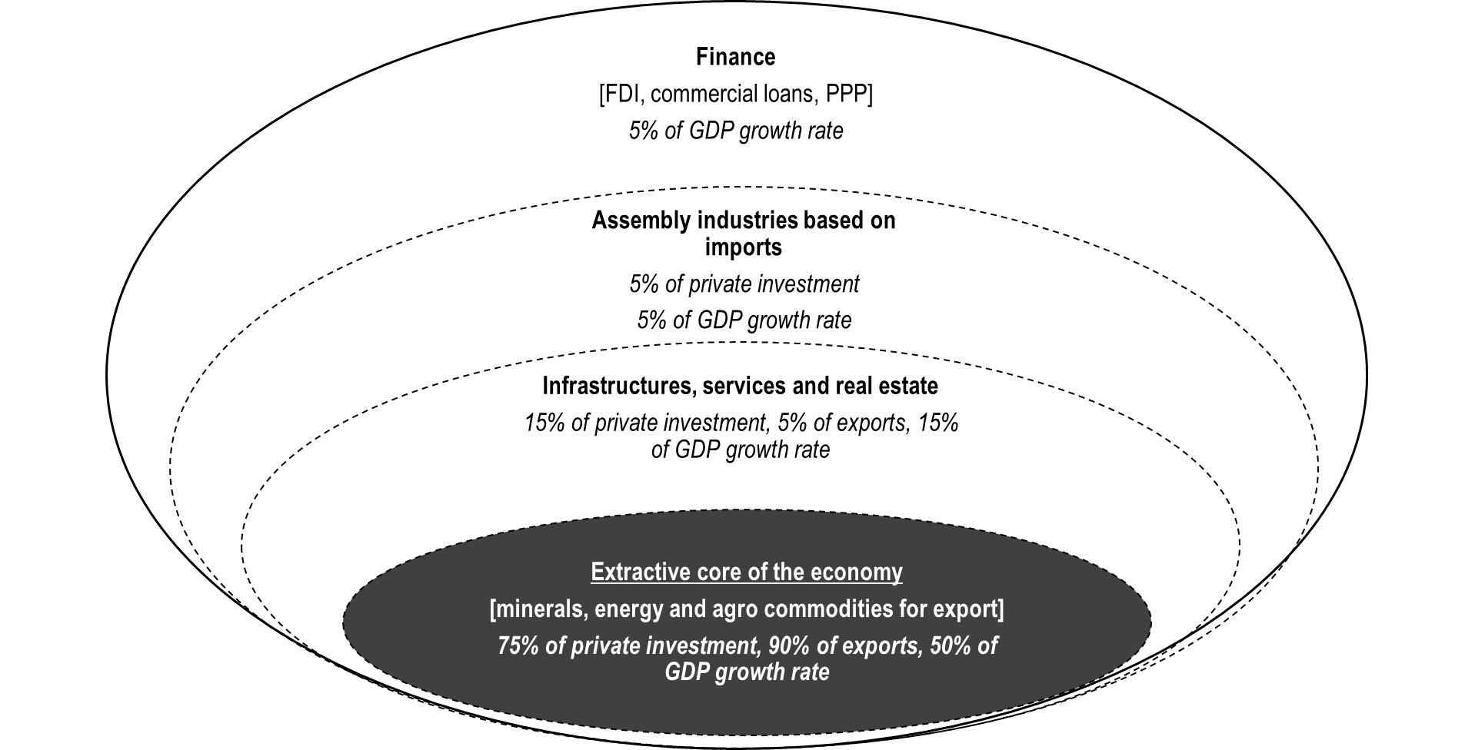
Magnitude of economic porosity – structure of economic dynamics

Slide 17
Magnitude of economic porosity – taxes on mega projects (social contribution of 2 mega projects as % of their total sales)
 | Total | Direct Taxes |  | Royalties |  | Corporate Social Responsibility % | Surface taxes %
 |  | IRPC % | IRPS % | Cash % | In kind %
Kenmare | 5% | 0,3% | 3% | 1% | 0% | 1% | 0,1%
Sasol | 5% | 0,003% | 0,3% | 1,5% | 2,5% | 1% | 0%
Total | 5% | 0,07% | 1% | 1% | 2% | 1% | 0,02%

Slide 18
Magnitude of economic porosity – taxes on mega projects [ratio of government revenue from corporate tax (IRPC) to personal income tax (IRPS), with and without tax incentives on mega projects – base 100 index]
 | 1999 | 2000 | 2001 | 2002 | 2003 | 2004 | 2005 | 2006 | 2007 | 2008 | 2009 | 2010
IRPC/IRPS with incentives | 88 | 60 | 55 | 50 | 40 | 42 | 53 | 67 | 91 | 96 | 96 | 114
IRPC/IRPS without incentives | na | na | na | na | 43 | 107 | 127 | 149 | 173 | 149 | 135 | 128

Slide 19
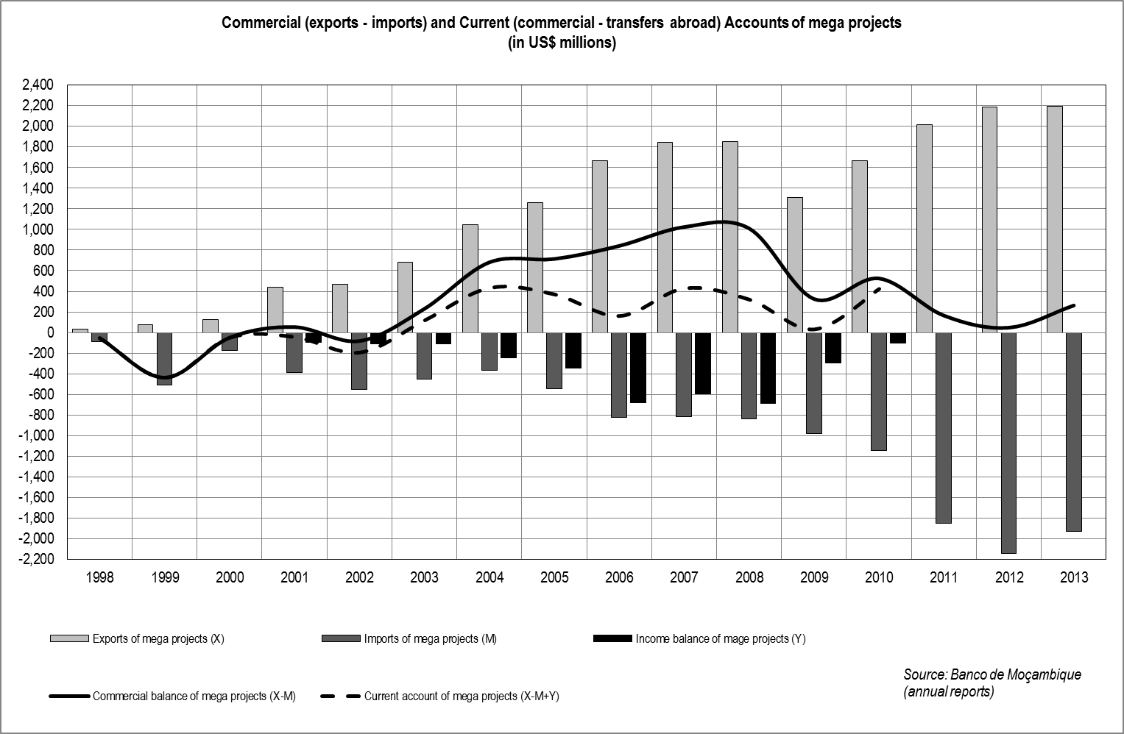
Magnitude of economic porosity – taxes on mega projects

Slide 20
Magnitude of economic porosity – taxes on mega projects
Losses from tax incentives between 2003-2013: approximately US$ 2 billion from 3 companies only (Mozal, Kenmare and Sazol), for which we have more systematic data.
Taxes on capital gains from transactions between multinationals of concessions of Mozambican natural resources:
  Loss of approximately US$ 1.6 billion over the period 2009-2013, prior to taxation being introduced
  Capital gains tax has become the single most important source of direct tax revenue. The Tax Authority reports that they are monitoring, for tax purposes, 15 such cases – this shows that it can be done, but also shows the extent of negotiation between multinationals with minerals-energy concessions

Slide 21
Magnitude of economic porosity – capital flight and physical assets
Physical assets (no precise financial data available)
  Public infrastructures allocated to private concessions (railways and ports)
  Land concessions that are not taxed or taxed at very low rates (0.40 cents of a USD for large, commercial projects, half of which have not been taxed)
  Large minerals-energy concessions (different world experts of minerals-energy projects have said tat Mozambican concessions to multinationals are too large), at low cost, which are then traded amongst multinationals
  Concessions of land, infrastructures and minerals-energy deposits to Mozambicans that are immediately traded with multinationals

Slide 22
Magnitude of economic porosity – taxes on mega projects
Can contracts be renegotiated?
  Would investment taken place with better contracts? Yes, because of corporate strategy (location advantages) and magnitude of the projects. Empirical studies shows the extent of redundancy of tax incentives. Would investment move away with renegotiation of contracts? No, because of the above plus magnitude of sunk costs.
  Would the government loose face? There are bigger problems facing multinationals in Mozambique. Negotiations can be tough and not yield all desirable results, particularly during a world crisis in markets/prices for some of the commodities involved, but there is no losing face particularly if they may be part of the solution to other structural problems of the economy that also affect multinationals. The government has renegotiated contracts before and is renegotiating some now. So, why not the fiscal component of contracts with mega projects?
  Should the government spend its political capital on such negotiations when forecasts point to huge revenue accruing from gas, oil and coal in the future? Such forecasts also show that such potential, future revenue will not be available for another decade or more, and that the actual revenue available is difficult to predict because of fluctuations in world market prices and because so much of future income has already been spent in the guaranteeing of current public spending in infrastructures. Hence, it is unwise not to mobilise fiscal resources now and to rely on such a distant future. As we know, in the long run we are all dead.

Slide 23
Magnitude of economic porosity – Investment/reinvestment
Investment/Reinvestment:
  Multinationals: 3%-5% of their profits
  Where does private investment (foreign and domestic) go? Back to the minerals energy complex
  How much of approved private investment is actually implemented?

Slide 24
Magnitude of economic porosity – allocation and reproduction of surplus
 | Industry | Forests | Mineral Resources | Energy | Transports & Comunications | Turism | Total Mega Projects
Private investment approved for mega projects (1990-2012) (CPI data base)
In millions of US$ | 8.440 | 5.035 | 2.735 | 1.900 | 1.070 | 970 | 20.150
In % of total mega projects | 42% | 25% | 14% | 9% | 5% | 5% | 100%
In % of total private investment | 24% | 14% | 8% | 5% | 3% | 3% | 58%
Private investment implemented in mega projects (1990-2012)
In millions of US$ | 2.340 | 0 | 1.535 | 0 | 1,070 | 0 | 4.945
In % of the value apporved for the sector | 28% | 0 | 56% | 0 | 100% | 0 | 25%
In % of the total value of mega projects implemented | 47% | 0 | 31% | 0 | 22% | 0 | 100%
In % of total value of mega projects approved | 12% | 0 | 8% | 0 | 5% | 0 | 25%

Slide 25
Magnitude of economic porosity – capital flight
Licit and illicit capital flight – approximately equivalent to annual GDP growth rate
  Licit: 3%-4% of GDP, annually, mostly associated with tax incentives and imports of investment associated services;
  Illicit: 3%-5% of GDP, annually, mostly related to transfer pricing and undervaluation of export revenue involving multinationals

Slide 26
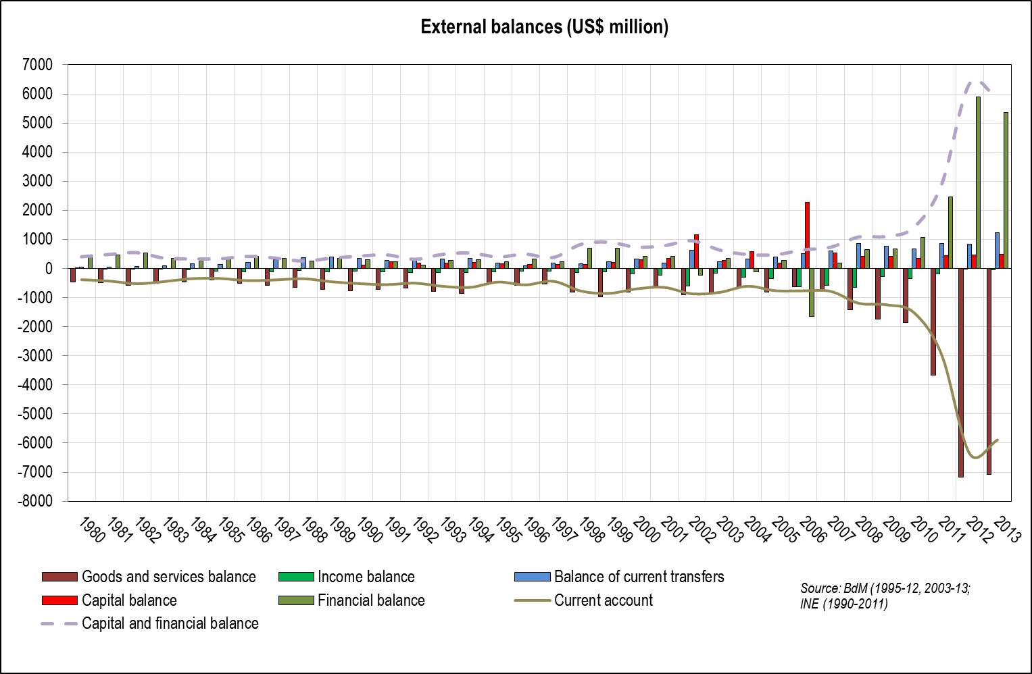
Magnitude of economic porosity – public debt

Slide 27
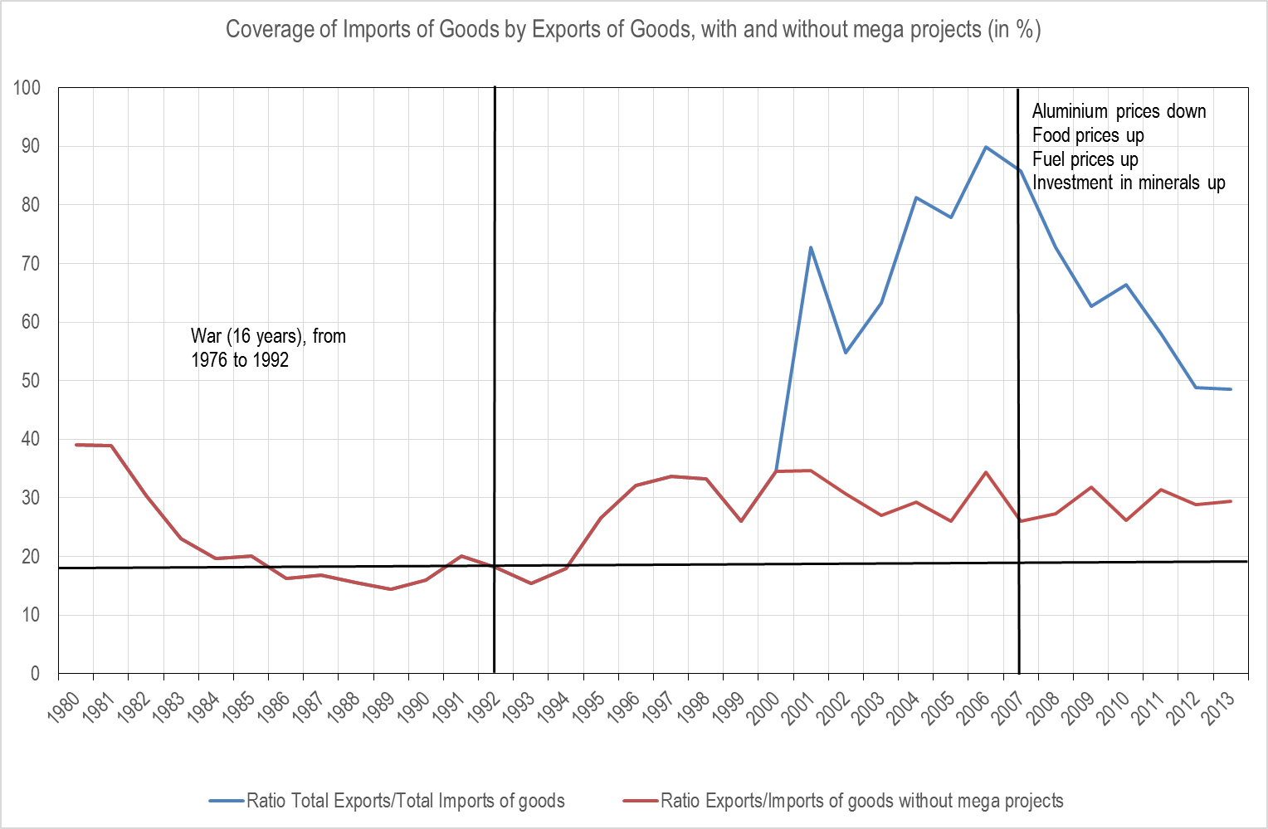
Magnitude of economic porosity – public debt

Slide 28
Magnitude of economic porosity – public debt
“Mining” the debt space:
  ‘Mining’ the debt space
  Debt space created by two decades of austerity under IMF supervision
  Debt space as a source of capital – attractive for investors for being public or publicly guaranteed, high premium in a high expectation economy, which has a stabilization program with the IMF (expectations of bailout if the worse scenario happens); attractive for the government because it’s finance without political conditionality and there is still space to mine; attractive for domestic private capital because it provides profit opportunities (publicly subsidised investment plus the debt business); attractive for multinationals because it commits large financial institutions to subsidising costs.
  Debt and aid – replaces aid as direct source of capital accumulation (endogenous to the model and without political conditionality); needs aid for sustainability and to be focused on large capital investment.

Slide 29
Magnitude of economic porosity – public debt

Slide 30
Magnitude of economic porosity – public debt

Slide 31
Magnitude of economic porosity – public debt

Slide 32
Magnitude of economic porosity – public debt
Project/Sector | Value (US$ millions) | Origin of funds
EMATUM (fishing, security and unknown applications) | 850 | Credit Suisse/VTB
Proíndicus (logistics, security and unknown applications – gás related) | 622 | Credit Suisse/VTB
MAM (logistics, security and unknown applications – gás related) | 530 | Credit Suisse/VTB
Defense and security | 300 | Credit Suisse/VTB
Ka Tembe Bridge and road to Ponta do Ouro | 725 | Exim Bank RP China
TOTAL | 3,027

Slide 33
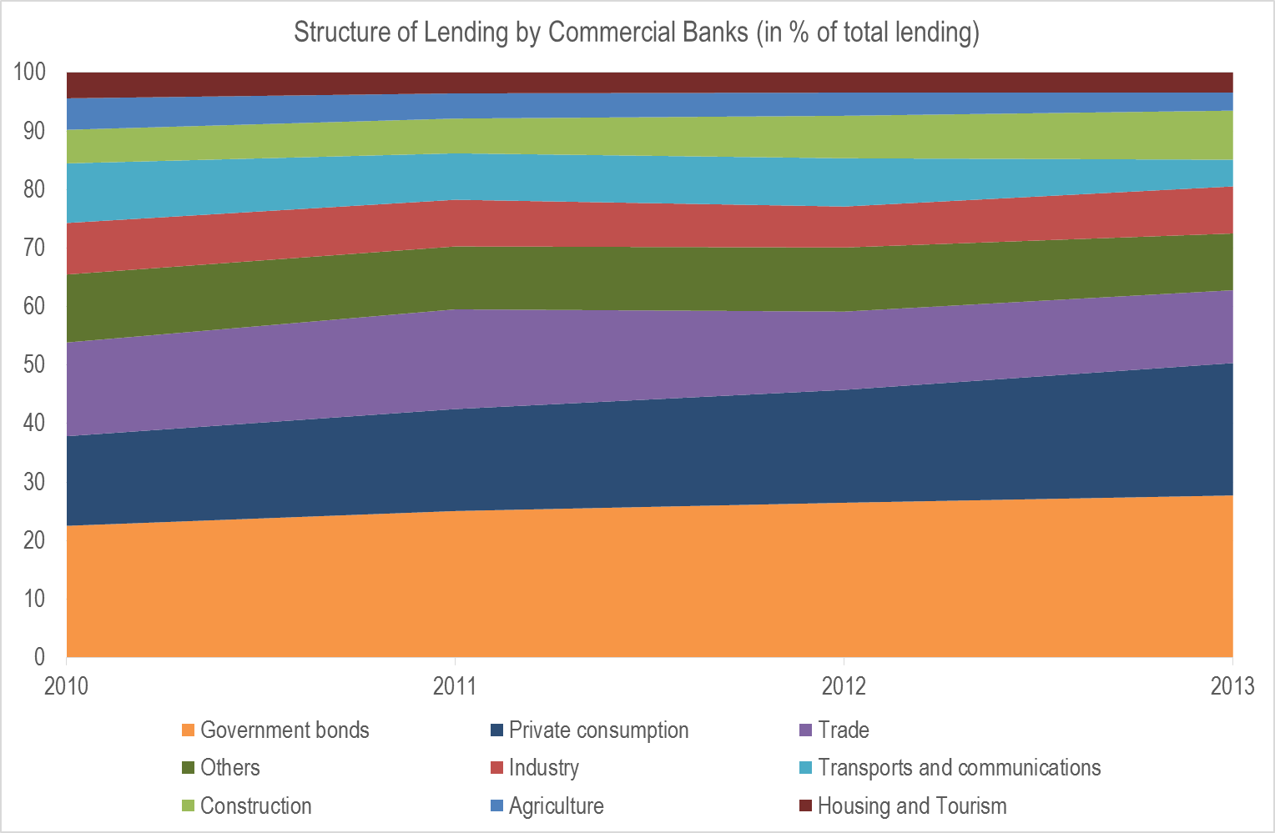
Magnitude of economic porosity – public debt and the financial system

Slide 34
Questions/challenges for “taxation and State building”

Slide 35
Questions/challenges for “taxation and State building”
Broader than taxation – economic and social strategy as a political economy issue
The debt issue – a mode of capital accumulation that is largely exhausted
  Auditing
  Restructuring and cancellation
  Changing dynamics: public revenue, public expenditure, consistency with economic growth and social and economic transformation
The alliances of the State:
  Social/political/economic contestation, tension, conflict and struggles for the State
  Social alliances: domestic and foreign
Can we save capitalism from itself? Should we try to do so? Should we save Mozambique from capitalism altogether?

Slide 36
Thank you!

